Slide 1
CrEDIT CARD DEFAULT PREDICTION
CAPSTONE PROJECT
Presented By:
1. Praveen Rasamalla-Pratibha Degree college-TASK Siddipet-BSc(Computer Science)

Slide 2
OUTLINE
Problem Statement
Proposed System/Solution
Data Summary
System Development Approach (Data analysis steps)
Algorithm
Result
Conclusion
Future Scope

Slide 3
Problem Statement
This project is aimed at predicting the case of customers default payments in Taiwan. From the perspective of risk management, the result of predictive accuracy of the estimated probability of default will be more valuable than the binary result of classification - credible or not credible clients. We can use the K-S chart to evaluate which customers will default on their credit card payments

Slide 4
Proposed Solution
The proposed system aims to address the challenge one of the muliti national banking company facing the problem on Frauds on credit card plat form ,I developed binary classification model using ML algorithms such as logistics Regression , Random forest , K-NN to predict whether customer will default on credit card payments . This involves leveraging data analytics and machine learning techniques to forecast demand patterns accurately. The solution will consist of the following components:
Data Collection:
Gather historical data on credit limit , age ,gender, education, payment delayed details, bill generated amount, bill paid amount, defaulter for next month.
Data Preprocessing:
Clean and preprocess the collected data to handle missing values, outliers, and inconsistencies.Feature engineering to extract relevant features from the data that might impact default prediction.
Machine Learning Algorithm:
Implement a machine learning algorithm, such as logistics Regression , Random forest ,K-NN to predict whether customer will default on credit card payments based on historical patterns.
Evaluation:
Assess the model's performance using appropriate metrics such as accuracy, precision, recall,f-1 score, confusion metricsFine-tune the model based on feedback and continuous monitoring of prediction accuracy.
Result:

Slide 5
Data Summary:
I took a data set consist of 30000 rows, 25 columns it consist of
X1 - Amount of credit(includes individual as well as family credit)
X2 – Gender
X3 – Education
X4 - Marital Status
X5 – Age
X6 to X11 - History of past payments from April to September
X12 to X17 - Amount of bill statement from April to September
X18 to X23 - Amount of previous payment from April to September

Slide 6
Data anaylasis steps:
Import Libraries: In this part, we had imported require libraries like numpy,pandas, matplotlib, seaborn, to perform Exploratory Data Analysis and For prediction we import sklearn library for credit card fraud detection.
Descriptive Statistics: In this part, we start by looking at descriptive statistic parameters for the dataset. We will use describe() this tell about unique values and standard deviation, mean, median, mode etc.
Missing Value Imputation: We will now check for missing values in our dataset. In case there are any missing entries, we will impute them with appropriate values.
Graphical Representation: We will start with Univariate Analysis. and end with bivariate analysis during this i draw pie chart, bar chart, count plot etc.

Slide 7
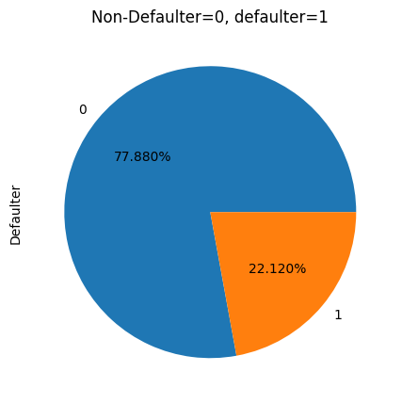
Exploratory Data Analysis:
Defaulters : Non-defaulter were 23364, Defaulter were 6636The above pie charts said Non-defaulters 77.88% ,and defaulter were 22.12%

Slide 8
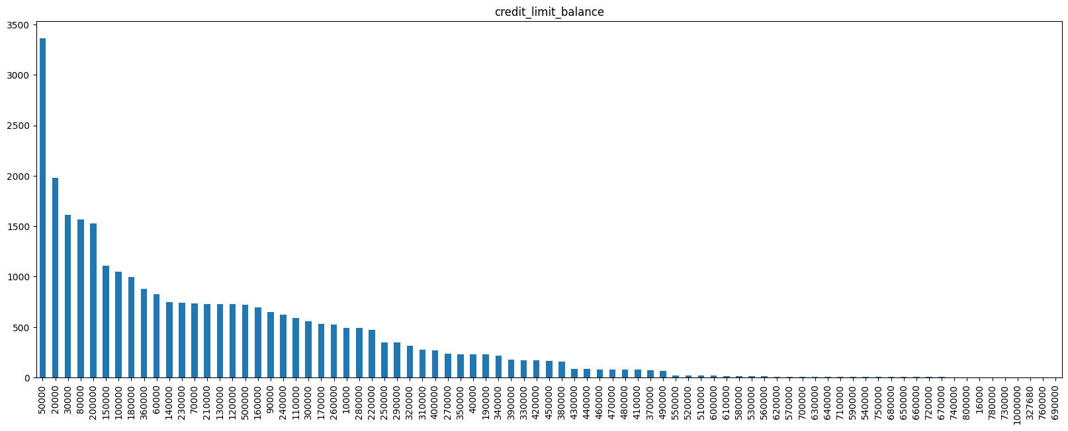
Credit limit balance Analysis:
Most of people available credit balance is 50,000 to 3365 members. Maximum available credit balance limit is 1,00,000Minimum available credit balance limit is 10,000

Slide 9
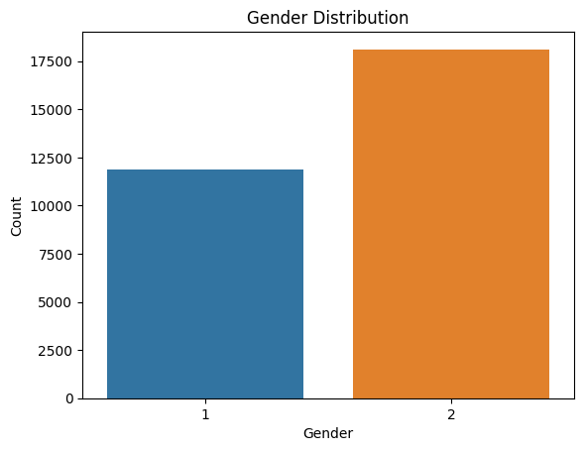
Gender analysis:
Gender Analysis
Male are 11,888 represented as 1 and female are 18,112 represented as 2

Slide 10
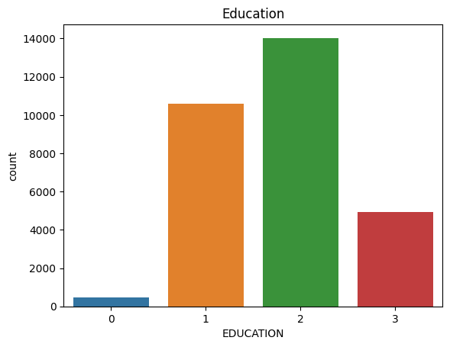
Education Analysis:
Graduate school by 10,585 people University by 14,030 people Graduate school by 4917 people
Other studying by 468 people

Slide 11
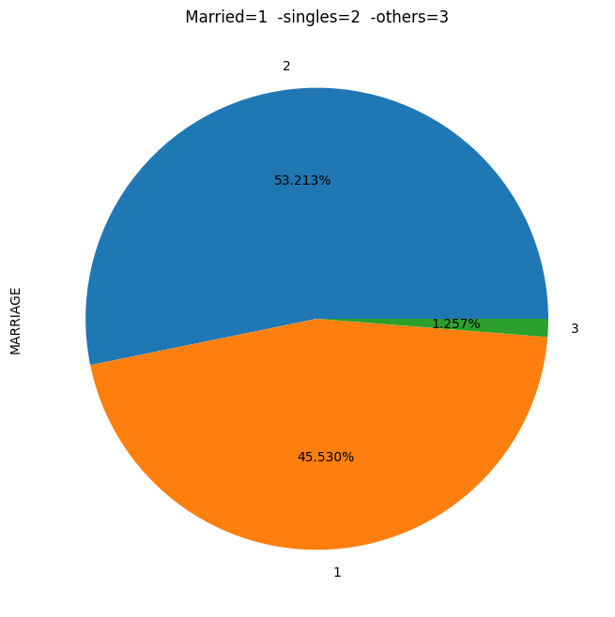
Marital Status Analysis:
Married persons are 13,659 represented as 1 Single persons are 15,964 represented as 2 Others are 377 represented as 3

Slide 12
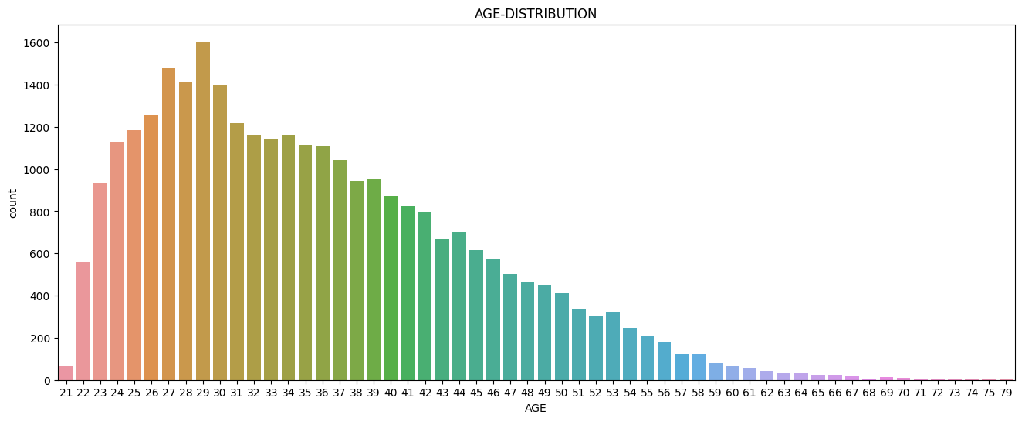
Age Distribution:
Most credit cardholders AGE was 25-45 and above age 60 people are used rarely credit cards Most of 29th age people used huge credit cards that number is 1605 and second place was 27th age people it's number 1477

Slide 13
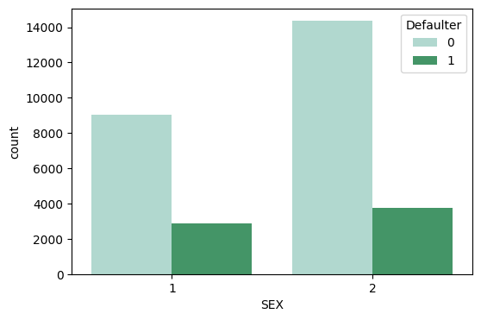
Bivariate analysis:
Gender wise Defaulters:
Defaulters were females, their number was 3763 and Height Non- defaulters also famales it's number 14,349

Slide 14
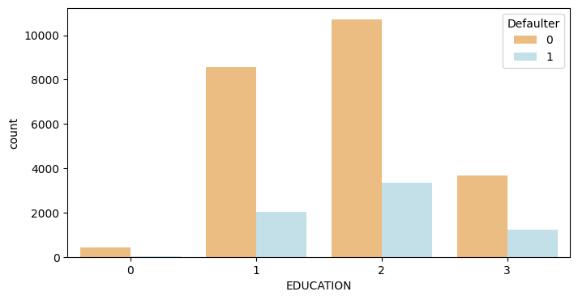
Education Wise Defaulters:
Defaulters who did study in University people its number was 3,330 and after that graduate school people are defaulter their number was 2036. 1 represented as graduate school,2 represented as university,3 represented as high school,0 represented as others

Slide 15
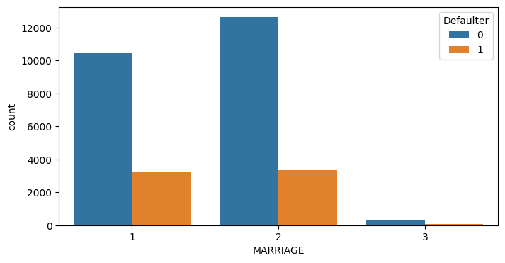
Marital Wise Defaulters:
Most of the defaulters were singles their numbers was 3341 and defaulters in married people were 3206 and defaulters in others were 89.

Slide 16
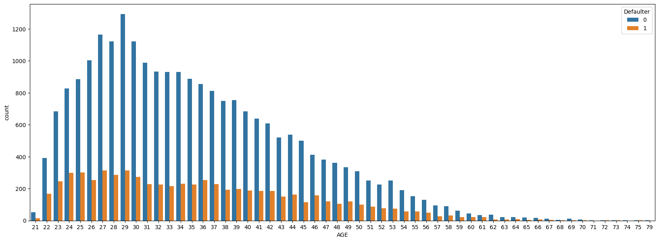
Age Wise Defaulters:
Most of 27th age people defaulters least defaulters were above 60age people were defaulters

Slide 17
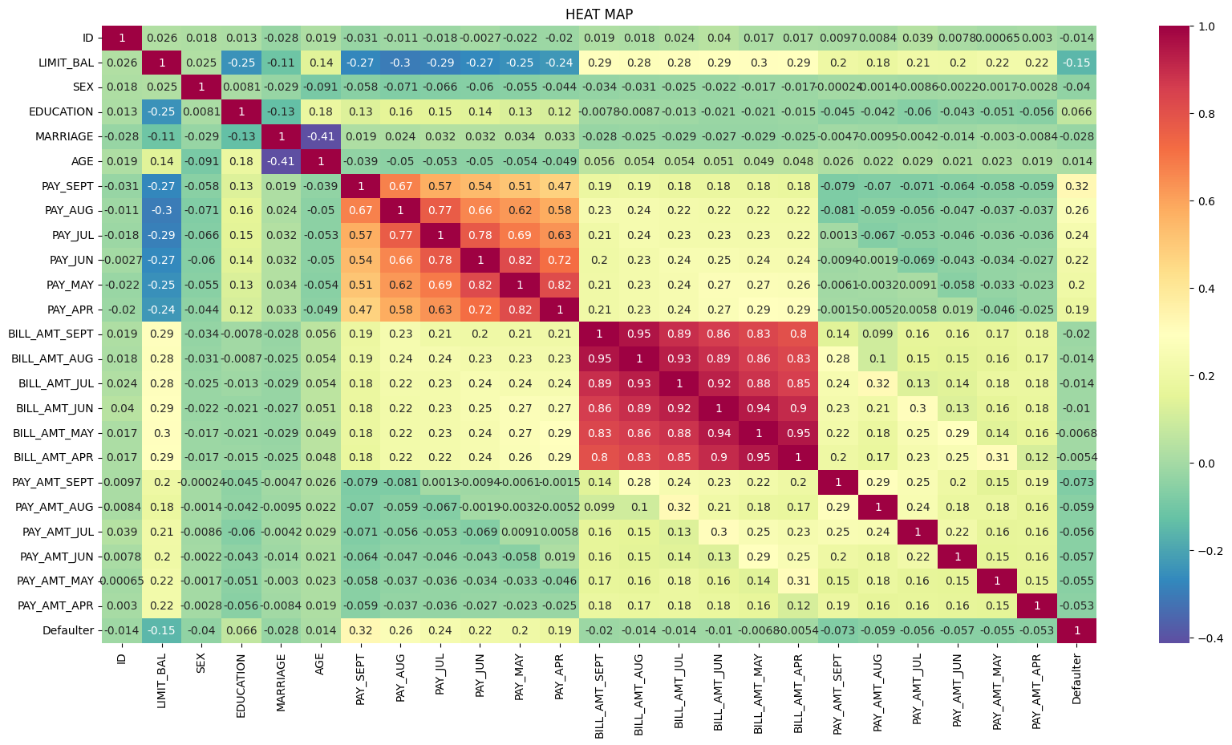
Heatmap Correlation:
In this heatmap we can conclude that correlation relationship between any two columns,some part of data having highly correlated,some part of data having negative correlated and some data have zero correlated.

Slide 18
feature engineering:
For selection of features ,I implemented VIF technique to select the important featuresThere is no categorical data for using of label or one-hot- encoding All features are different values to make the better performance of model applied Robust feature scalling.

Slide 19
Challeng: Applying SMOTE(Synthetic Minority Oversampling Technique):
After dataset is imbalanced dataset so we need to do the balance using SMOTE(Synthetic Minority Oversampling Technique)We got,Original dataset shape Counter({0: 18691, 1: 5309})Resample dataset shape Counter({1: 23364, 0: 23364})Counter({0: 23364, 1: 23364})

Slide 20
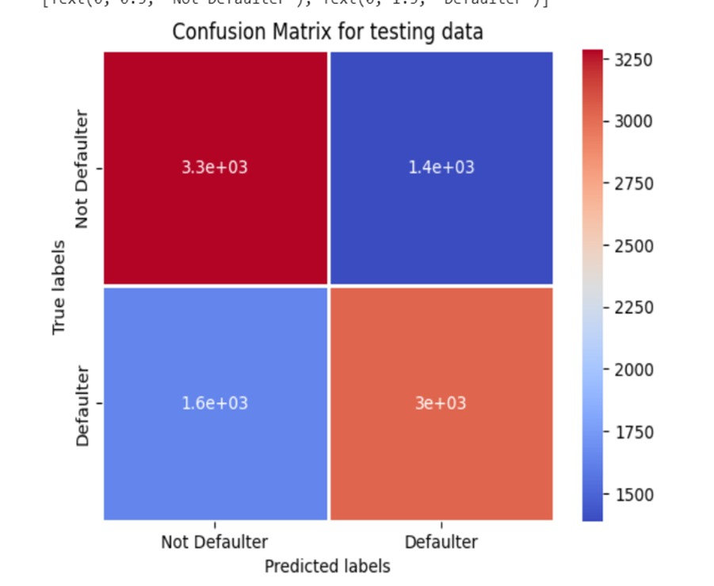
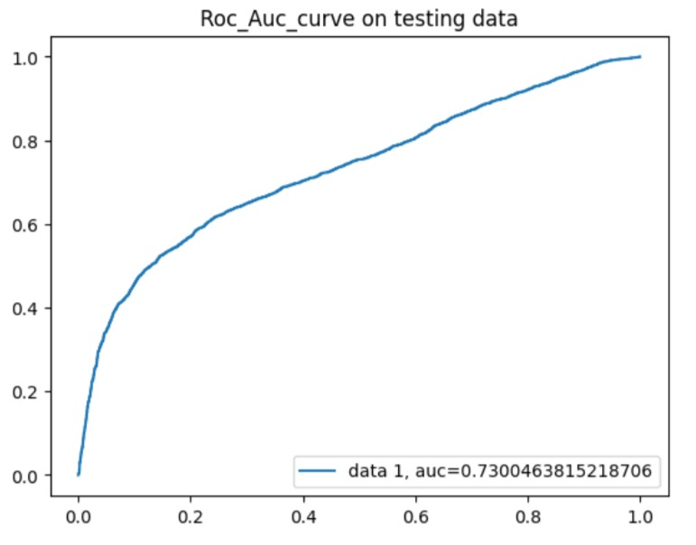
Algorithms:
In the Algorithm section, describe the machine learning algorithm chosen for predicting bike counts. Here's an example structure for this section:
Logistic Regression
We have implemented logistic regression and we getting accuracy_score is approx 67%. and precision score approx is 68% and f1_score is 66%and roc_auc approx is 67% As we have imbalanced dataset, recall_score is approx 64% better parameter. Let's go ahead with other models and see if they can give better result

Slide 21
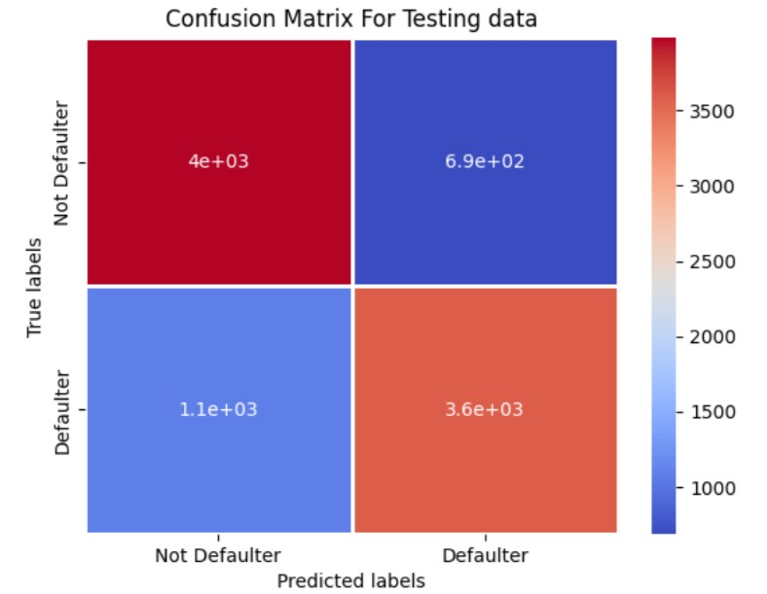
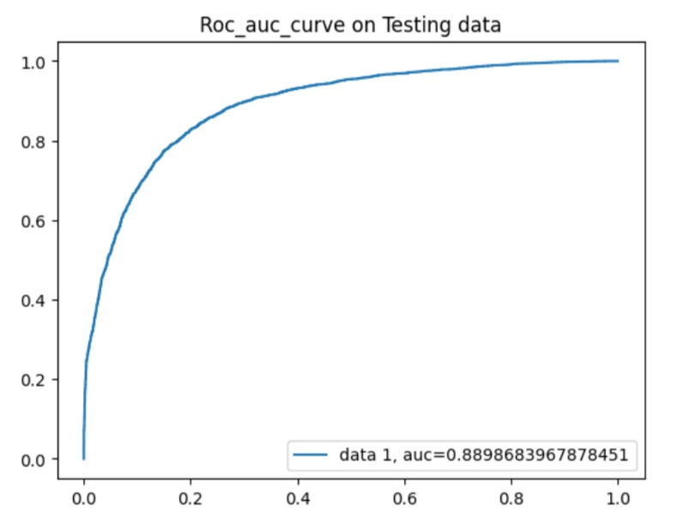
Random Forest Classifier:
we have been implemented Random Forest and we getting accuracy_score is approx 81%. and recall_score is approx 76% and f1_score is 80% and ROC_AUC score is 81% ,precision score is approx 84% better parameter. Let's go ahead with other models and see if they can give better result

Slide 22
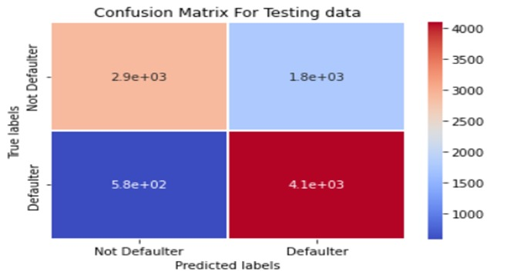
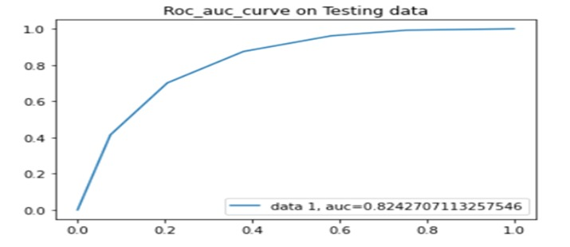
KNN Classifier:
we have been implemented Random Forest and we getting accuracy_score is approx 78%. and recall_score is approx 767% and f1_score is 80% and ROC_AUC score is 78% ,precision score is approx 76% better parameter. Let's go ahead with other models and see if they can give better result

Slide 23
Result
Present the results of the machine learning model in terms of its accuracy and effectiveness in predicting credit card defaulters. Include visualizations and comparisons between predicted and actual counts to highlight the model's performance.

Slide 24
Conclusion
By used different type of Classification algorithms to train our model like, Logistic Regression, Random Forest Classifier,KNN_Classifier,and Also we tuned the parameters of Random forest classifier and XGboost classifier ,KNN_ Out of them Random forest classifier with Grid search CV ( tuned hyperparameters gave) the best result.
Highest Precision score is approx 84%,
ROC_Auc score is approx 81%,
Accuracy_score is approx 81%
It's F1_score approx is 80%,
Recall_score approx is 77%

Slide 25
This ML model helps to any credit card details enter machine autondically evduted whether he default in future or not and it reduces an expected losses and baddefts all banking industry in the form of credit defaulters
Future scope

Slide 26
THANK YOU

